Slide 1





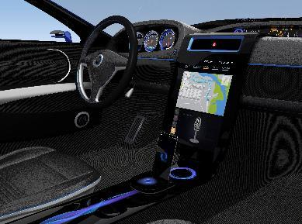



产品关键尺寸和螺纹通止规检测方案

Slide 2


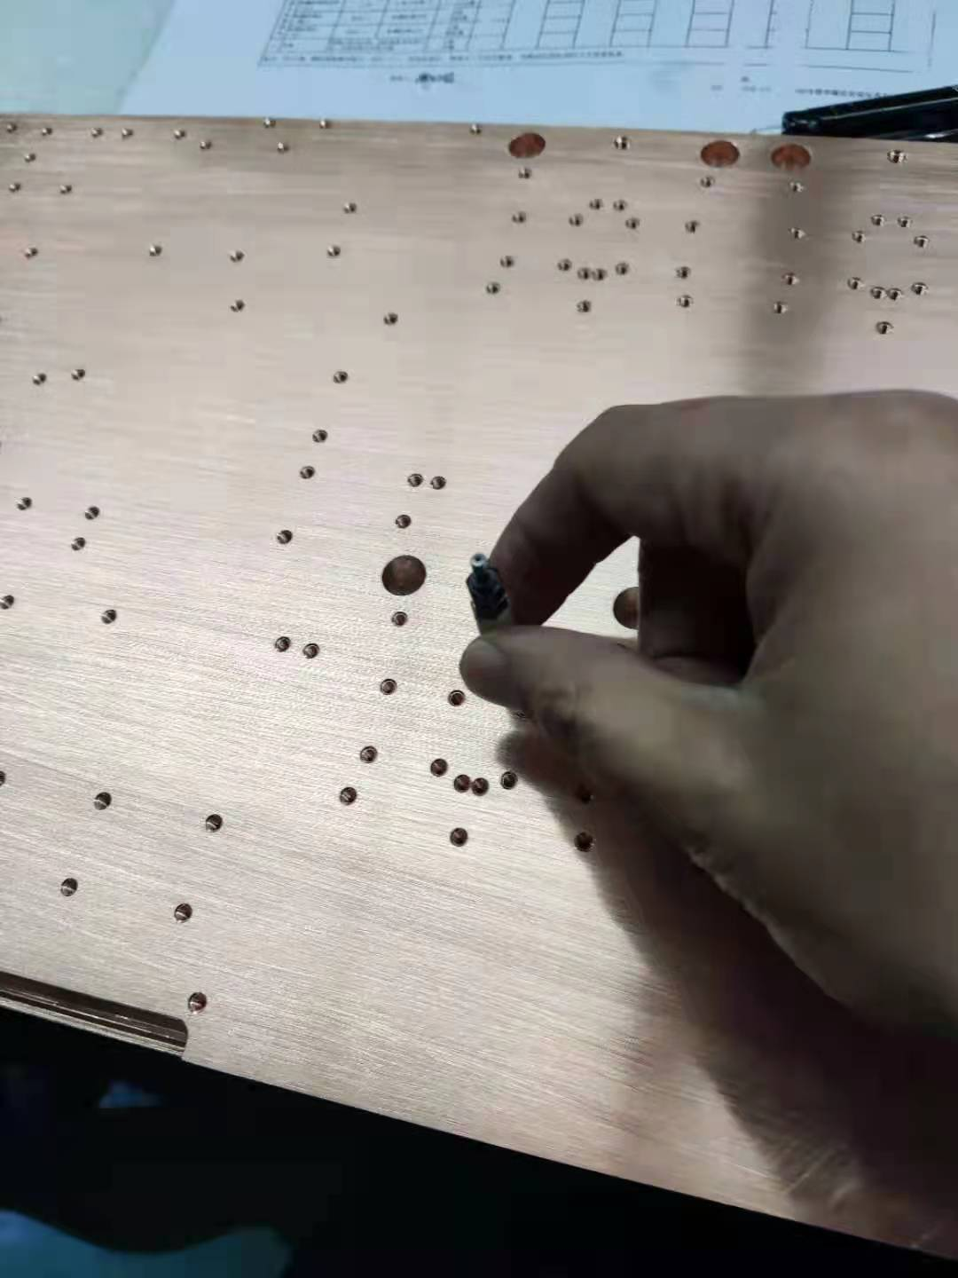
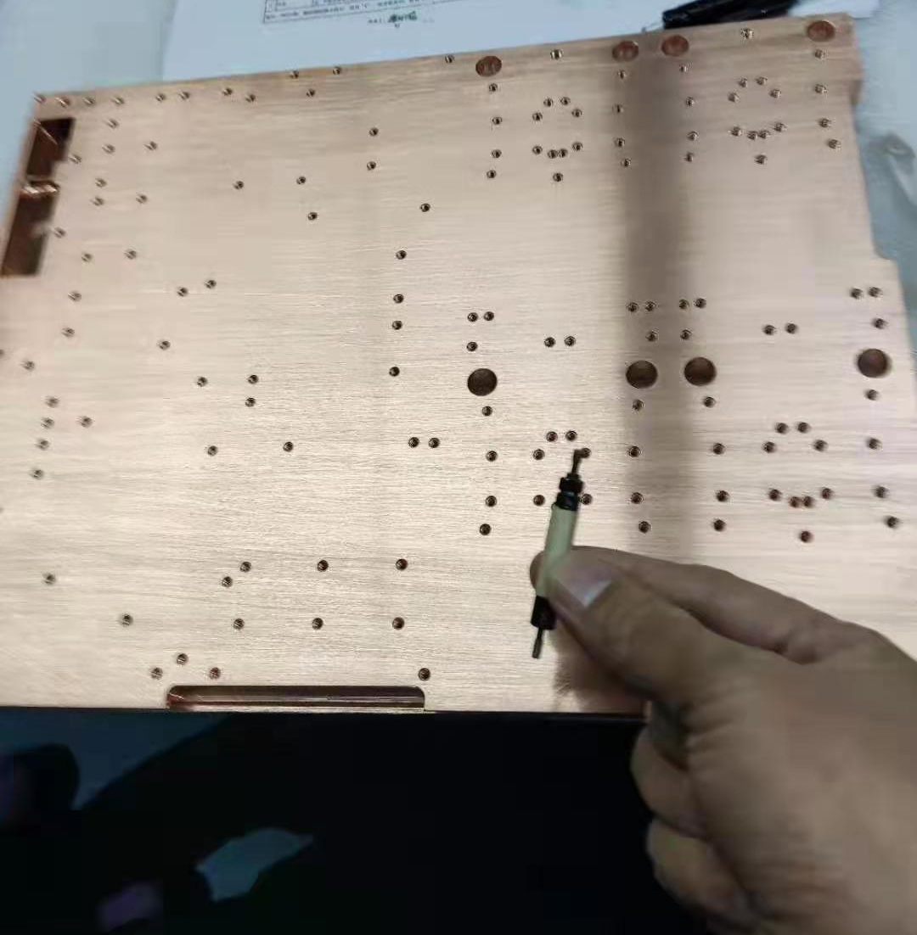
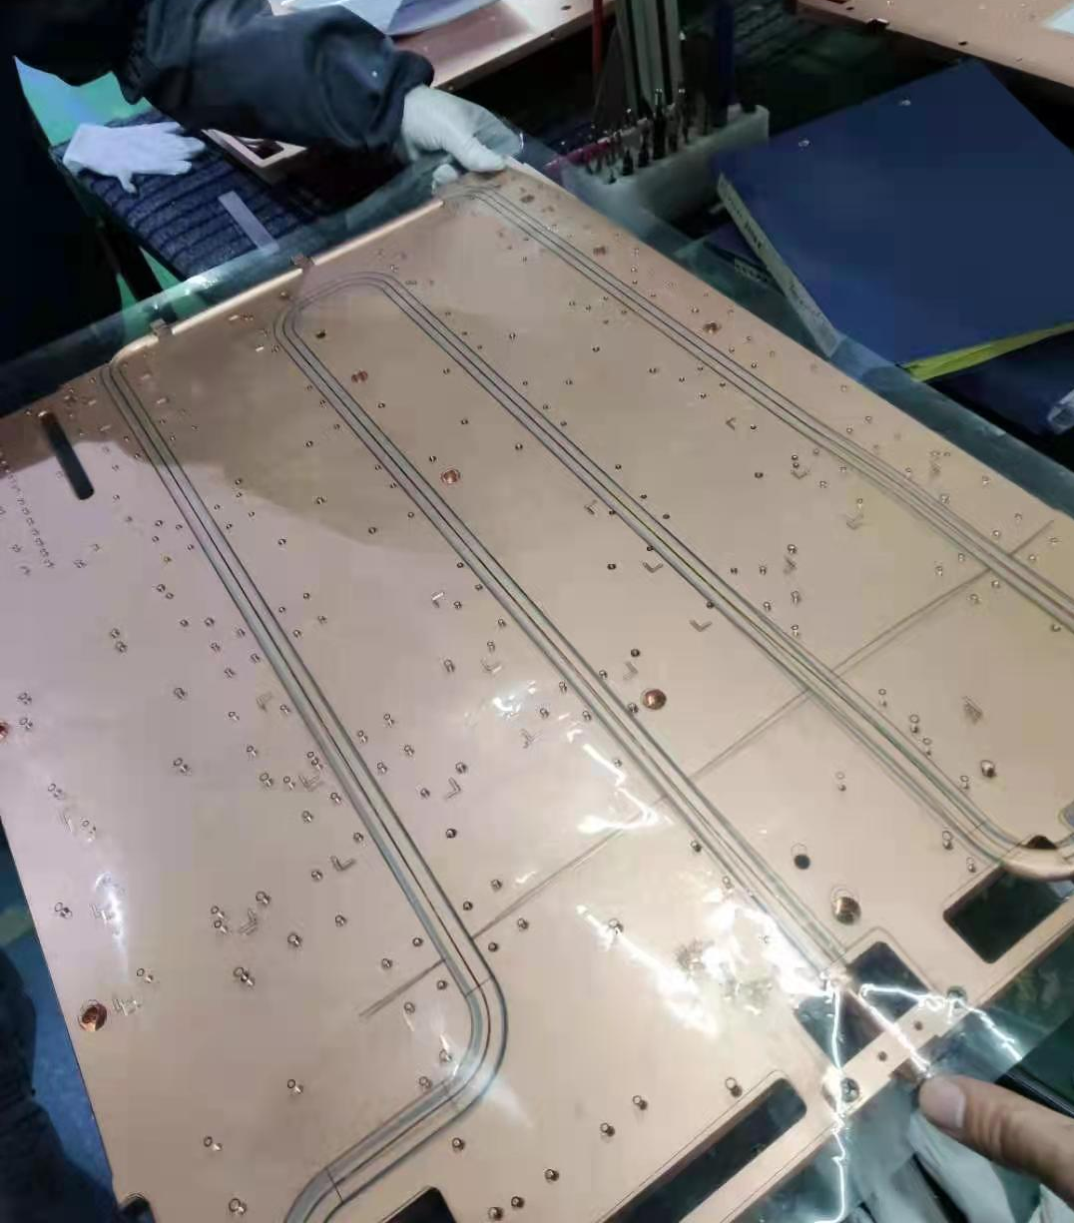
手动生产现状
1，NPT螺纹检测：螺纹规通端通，止规最多拧入2.5圈，螺纹同时满足上述两个条件为合格
2，螺纹通孔检测：把通规旋进螺纹孔，顺利通过判断OK，若感觉阻力，无法旋入判断NG;止
规M3/4/5最多拧进2.5圈为合格，M6最多拧进3圈为合格
人工把菲林片贴合在产品表面，看特征是否吻合，
若肉眼判定加工位置与菲林位置不符合，判断为
NG，符合则判定为OK
Notes:
Final day of the Kaizen event…there should be minimal amounts of new activity on the shop floor. Shop floor activity should be focused on posting standard work and training individuals on new processes.
The final report out needs to be prepared.
A typical format for the final report out is:
- Title Page
- Project Charter
- A slide on tools used and benefits derived
- A slide showing results with before and after pictures
- The last slide should be the Kaizen Newspaper

Slide 3
设备性能要求
1，满足公司现有产品关键尺寸和螺纹通止规检测的通用性需求；适应范围：产品尺寸最大检测尺寸750*650，最小尺寸300*300，重量范围：5KG至35KG，材质：铜/铝；
2，CCD检测精度：±0.02，产品与通止规的重复定位精度±0.02 ，通止规检测力度精度为± 0.2kgf；
3，换款1小时内完成（生产过的产品）；
4，模块化设计，每个模块可快速拆装定位/调整，程序用配方的形式储存，不同产品间灵活调用；
5，判断准确良率≥99%，稼动率≥95%，故障率不超过1%（按20小时算）；
6，具备半自动调试和自动运行功能，各部件故障需有报警、显示输出，设备异常时，屏幕需明确显示故障内容并且明确指向故障点位；
7，编程方式：导入CAD图档与手动编程结合；
8，设备运行噪音不大于70分贝
9，效率要求：视觉定位拍照：2秒/位置，通规检测：6秒/位置，止规检测速度：3秒/位置；
10，通规检测阻力超过0.5+0.1kgf 标记为不良品，止规检测阻力超 过0.4+0.1kgf标记为良品，阻力检测精度为： ± 0.2kgf，设备屏幕需显示出不良位置和不良内容。
11, 检测内容：烂牙，滑牙，未攻牙，螺纹底孔过大或者过小
12，设备需具备扫码和MES上传功能
13，使用环境：温度:5~40度/湿度:20~90%，气压：0.4—0.6Mpa，用电：220V 50HZ
Notes:
Final day of the Kaizen event…there should be minimal amounts of new activity on the shop floor. Shop floor activity should be focused on posting standard work and training individuals on new processes.
The final report out needs to be prepared.
A typical format for the final report out is:
- Title Page
- Project Charter
- A slide on tools used and benefits derived
- A slide showing results with before and after pictures
- The last slide should be the Kaizen Newspaper

Slide 4
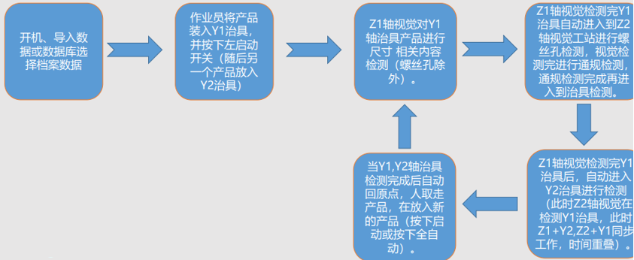
自动化工艺流程
Notes:
Final day of the Kaizen event…there should be minimal amounts of new activity on the shop floor. Shop floor activity should be focused on posting standard work and training individuals on new processes.
The final report out needs to be prepared.
A typical format for the final report out is:
- Title Page
- Project Charter
- A slide on tools used and benefits derived
- A slide showing results with before and after pictures
- The last slide should be the Kaizen Newspaper

Slide 5
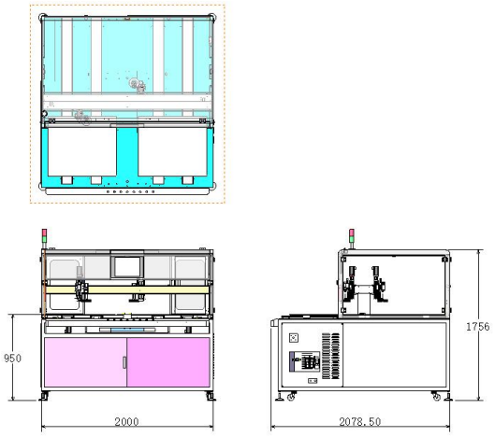
设备外形尺寸
Notes:
Final day of the Kaizen event…there should be minimal amounts of new activity on the shop floor. Shop floor activity should be focused on posting standard work and training individuals on new processes.
The final report out needs to be prepared.
A typical format for the final report out is:
- Title Page
- Project Charter
- A slide on tools used and benefits derived
- A slide showing results with before and after pictures
- The last slide should be the Kaizen Newspaper

Slide 6
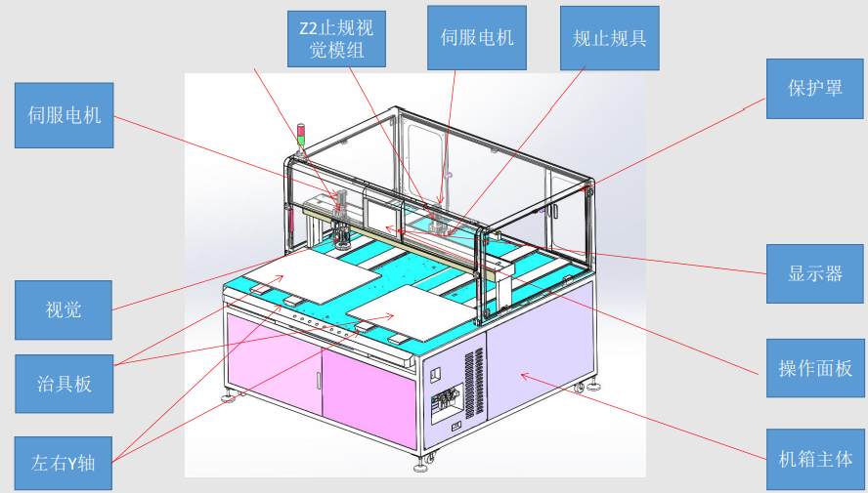
设备功能布局
Notes:
Final day of the Kaizen event…there should be minimal amounts of new activity on the shop floor. Shop floor activity should be focused on posting standard work and training individuals on new processes.
The final report out needs to be prepared.
A typical format for the final report out is:
- Title Page
- Project Charter
- A slide on tools used and benefits derived
- A slide showing results with before and after pictures
- The last slide should be the Kaizen Newspaper

Slide 7
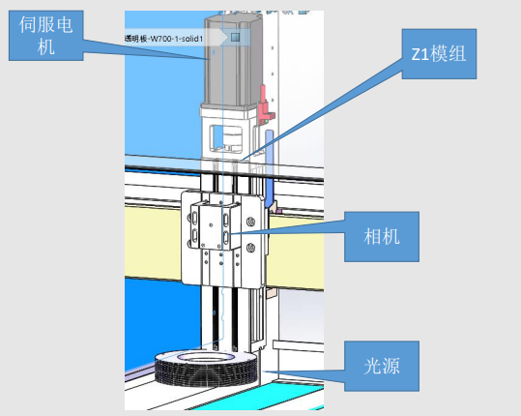
设备功能介绍
Notes:
Final day of the Kaizen event…there should be minimal amounts of new activity on the shop floor. Shop floor activity should be focused on posting standard work and training individuals on new processes.
The final report out needs to be prepared.
A typical format for the final report out is:
- Title Page
- Project Charter
- A slide on tools used and benefits derived
- A slide showing results with before and after pictures
- The last slide should be the Kaizen Newspaper

Slide 8
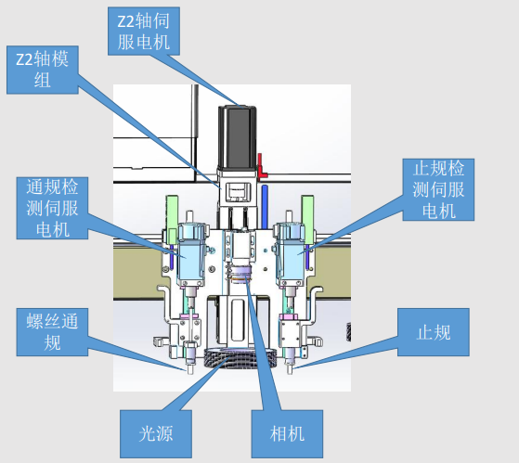
设备功能介绍
Notes:
Final day of the Kaizen event…there should be minimal amounts of new activity on the shop floor. Shop floor activity should be focused on posting standard work and training individuals on new processes.
The final report out needs to be prepared.
A typical format for the final report out is:
- Title Page
- Project Charter
- A slide on tools used and benefits derived
- A slide showing results with before and after pictures
- The last slide should be the Kaizen Newspaper

Slide 9
设备关键配置要求
1 ，输入电源： 220VAC±5% 50Hz；
2， 气压5~6KG；
3 ，PLC：三菱、欧姆龙、松下
4，步进电机：台达/三菱/安川
5， 伺服电机：松下/三菱/安川
6 ，气动元件：SMC/ATC
7，标准配件如联轴器/同步带/齿轮齿条，微调工作台等：怡合达/米思米
8， 丝杆/导轨/模组：上银/NSK
9 ，压力传感器：富士
10， 光纤/光电/接近/位移/激光传感器：基恩士/欧姆龙
11，减速/调速电机：晟邦；
12，触摸屏：威纶；
13，轴承：NSK；
14，四轴机械手：雅马哈或爱普生，
15，六轴机械手：发那科或ABB，
16，电气配件：施耐德/欧姆龙/基恩士/明纬，部分小配件可选正泰等国内一线品牌
17，凸轮分割器：德士/潭子
18，相机：BASLER，镜头：富士
设备按电工标准布线，所有线均有线码，且和IO分配表一致；配备整线及各工站操作说明书/电路图/IO分配
表/易损件清单的纸档、电子档各一份，非客观原因并得到同意的情况下，优先第一品牌
Notes:
Final day of the Kaizen event…there should be minimal amounts of new activity on the shop floor. Shop floor activity should be focused on posting standard work and training individuals on new processes.
The final report out needs to be prepared.
A typical format for the final report out is:
- Title Page
- Project Charter
- A slide on tools used and benefits derived
- A slide showing results with before and after pictures
- The last slide should be the Kaizen Newspaper

Slide 10
One Company, Many Solutions
www.boydcorp.com

